Slide 1
Control-law comparison
on the 6-12-8 system
Twelve runs · six laws · drive-coherence cap on and off · linear plant
rattlesnake-vibration-controller
branch control-law-development-2026-09 · 15 September 2026
Notes:
Twelve runs on one linear plant with every other setting held fixed and machine-verified across 23 settings. Six laws, each with the drive-coherence cap on (0.95) and off (1.0). Runs 01-08 are the four closed-loop laws; runs 09-12 added pseudoinverse_control and buzz_control, the two original upstream open-loop laws.
Three findings drive the deck: the coherence cap means opposite things to feedback and open-loop laws; a law with no error feedback finishes within 0.7 dB of the best feedback law; and the plant is rank 5, not 6, which makes part of the specification unreachable by construction.

Slide 2
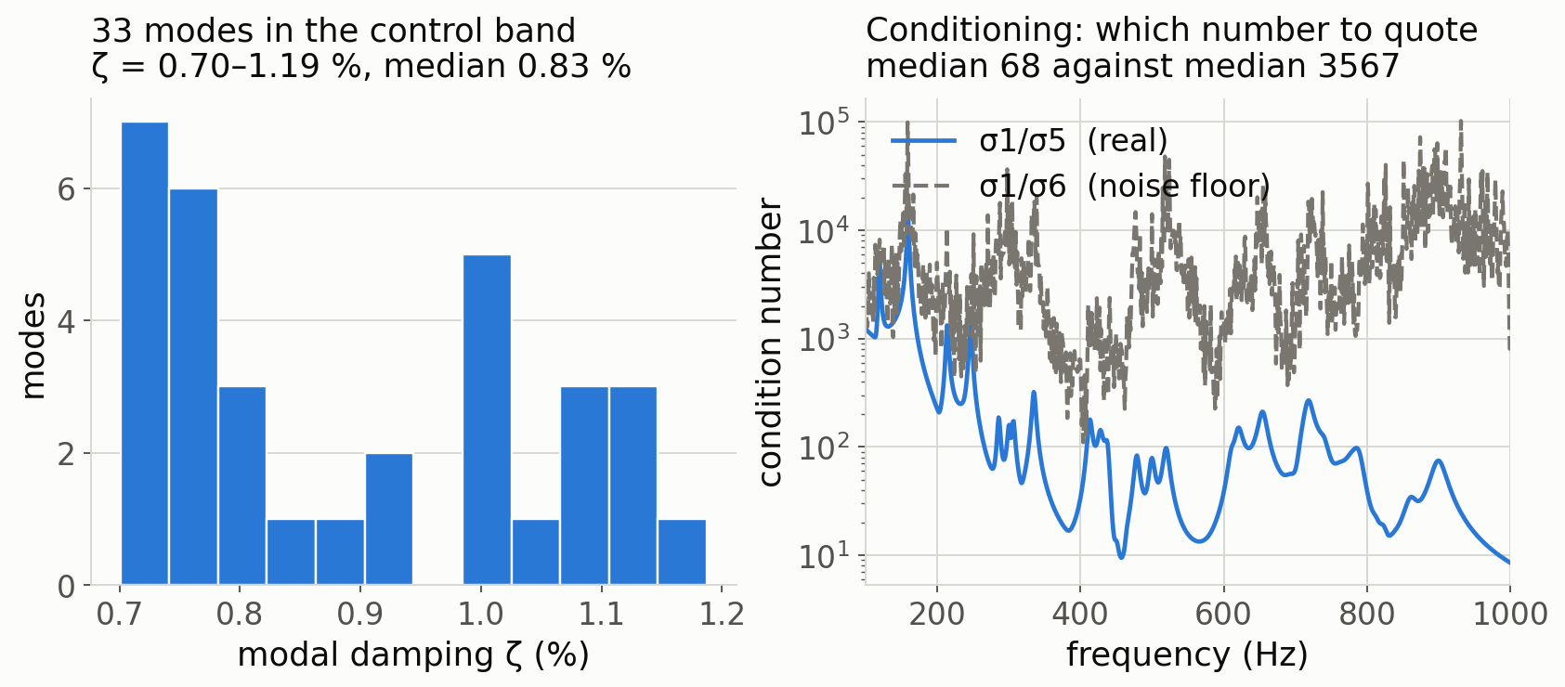
The system under test
2
Six drives, twelve responses, eight control channels, 100–1000 Hz
Six drives in, eight channels controlled
Twelve responses are measured; the first eight are the control set (nodes 7–14, X direction). All six shakers drive.
But only five directions exist
The FRF is rank 5, so part of the flat specification is unreachable by any law — before control design enters the picture at all. Slide 3 has the evidence.
33
0.83 %
4096 Hz
1×10⁻³
modes in the control band
median modal damping
(0.70–1.19 %)
sample rate, virtual
hardware (type 6)
flat spec, zero
cross-terms
Linear SDynPy frame model sdynpy_frame6x12_system.npz, 36 DOF, run as virtual hardware.
Notes:
Lightly damped structure — median zeta 0.83 %, minimum 0.70 % — which is the harder case for control. A better-damped twin exists (sdynpy_frame6x12_system_higherz.npz, identical mass and stiffness, zeta raised to a 3.34 % median); its reachability floor is 4.05 dB against this plant's 4.09, so damping does not change what is reachable — it halves the conditioning.
Left panel: modal damping histogram. Centre: reachability floor per run at the rcond the laws use, against unrestricted over the real rank-5 subspace — they agree, which is the point. Right: median cond(H) per run, scattering by a factor of ten across identical identifications of a deterministic plant. See slide 3 for why that scatter is an artefact.

Slide 3
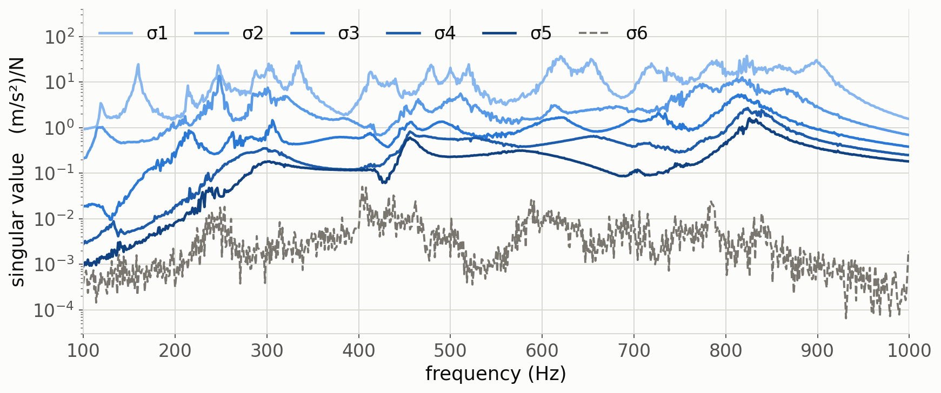
The plant is rank 5, not 6
3
Six shakers span a five-dimensional response subspace at these eight locations
 | σ1 | σ2 | σ3 | σ4 | σ5 | σ6
analytic, dB re σ1 | 0.0 | -9.9 | -21.5 | -29.9 | -36.7 | −327
measured, dB re σ1 | 0.0 | -10.1 | -21.2 | -29.4 | -36.1 | -71.0
Quote σ1/σ5, not σ1/σ6
Real conditioning is 68 (analytic), 64 (measured). The cond(H) column in the report is σ1/σ6 ≈ 3567 — that is the identification noise floor, which is why it scatters ten-fold.
Notes:
Computed exactly from the model mass, stiffness and damping matrices. Validated against the measured FRF: magnitude agrees to a median 0.21 dB and sigma1..sigma5 reproduce to a few tenths of a dB. Sigma6 is ~1e-16 analytically — machine round-off on a 36-DOF solve — and 2.4e-3 measured, which is identification noise, not a sixth direction. Numeric rank is 5 in all twelve runs.
Two consequences. First, rcond = 1e-3 is doing the right thing by truncating that direction; an earlier draft of the report claimed 1.6 dB of headroom was being lost to the truncation, which was wrong and has been withdrawn. Second, the sixth drive direction produces no response at these eight locations — worth checking whether that is by construction, because on a real rig it would mean a shaker doing nothing.

Slide 4
What was run
4
One plant, one configuration, twelve runs — comparability checked by machine
Control law | Loop | Runs (cap on / off)
match_trace_pseudoinverse | feedback | 01 / 02
optimal_diagonal_control | feedback | 03 / 04
optimal_diagonal_control_fast | feedback | 05 / 06
match_diagonal_congruence | feedback | 07 / 08
pseudoinverse_control | open-loop | 09 / 10
buzz_control | open-loop | 11 / 12
Held fixed across all twelve
samples per frame 4096
sample rate 4096 Hz
frames in CPSD 20
control averaging Exponential 0.04
update sys ID Y
sys ID averages 20
sys ID level 1.0 V rms
rcond 1e-3
23 settings are compared across runs by score_runs_sdynpy.py’s MUST_MATCH list. A mismatch raises a NOT-COMPARABLE warning rather than being scored silently — a response to an earlier campaign where sixteen runs turned out to span three different plants.
Notes:
Every run used the same plant, sample rate, averaging and system-ID configuration. The MUST_MATCH provenance check exists because of a real failure: an earlier sixteen-run set was scored as one comparison and turned out to span linear, shifted and nonlinear plants with differing update_tf_during_control.
Cap on means max_drive_coherence = 0.95; cap off means 1.0, which is a no-op. Note the cap sits in parameter position 2 for four of the laws but position 5 for the two optimal-diagonal laws — an easy thing to get wrong when reading profiles.

Slide 5
Results
5
Scored against the flat specification, and against what the plant can deliver
Run | Law | Loop | Cap | rms dB | % out | vs floor | drive V² | level dB
run01 | match_trace_pseudoinverse | fbk | 0.95 | 8.22 | 27.5 | 7.16 | 0.120 | +0.09
run02 | match_trace_pseudoinverse | fbk | off | 7.21 | 21.1 | 5.78 | 6.02 | +0.05
run03 | optimal_diagonal_control | fbk | 0.95 | 5.62 | 11.2 | 3.99 | 0.0747 | +0.08
run04 | optimal_diagonal_control | fbk | off | 5.62 | 11.2 | 3.99 | 0.0790 | +0.41
run05 | optimal_diagonal_control_fast | fbk | 0.95 | 5.64 | 10.9 | 3.99 | 0.0760 | +0.26
run06 | optimal_diagonal_control_fast | fbk | off | 5.66 | 10.7 | 3.99 | 0.0756 | +0.06
run07 | match_diagonal_congruence | fbk | 0.95 | 5.31 | 19.8 | 3.51 | 0.0469 | +2.85
run08 | match_diagonal_congruence | fbk | off | 5.23 | 18.7 | 3.48 | 0.211 | +2.78
run09 | pseudoinverse_control | open | 0.95 | 10.47 | 42.1 | 9.55 | 5.45 | +13.55
run10 | pseudoinverse_control | open | off | 7.01 | 17.8 | 5.48 | 5.38 | -1.28
run11 | buzz_control | open | 0.95 | 7.90 | 30.2 | 6.75 | 0.981 | +9.38
run12 | buzz_control | open | off | 5.91 | 13.6 | 4.20 | 1.47 | -0.30
rms dB and % out score against the flat specification. vs floor scores against the best achievable response — the law’s own contribution. Orange marks the best value in each column.
Notes:
Two acceptance criteria and they now mostly agree. congruence leads on rms (5.23), opt diag fast on lines-out (10.7 %), opt diagonal on error-against-floor (3.99, with congruence at 3.48 actually lowest — check the bold).
Key rows to point at: 09 versus 10 (pseudoinverse, cap on versus off — 10.47 to 7.01 dB) and 11 versus 12 (buzz, 7.90 to 5.91). Those are slide 6. And run 12 at 5.91 dB sits 0.68 dB behind the best run in the whole matrix despite having no error feedback at all — that is slide 8.
Caveat on run 01: its optimal single rescale is +3.37 dB, which suggests it was saved short of convergence. It is the weakest number in the table.

Slide 6
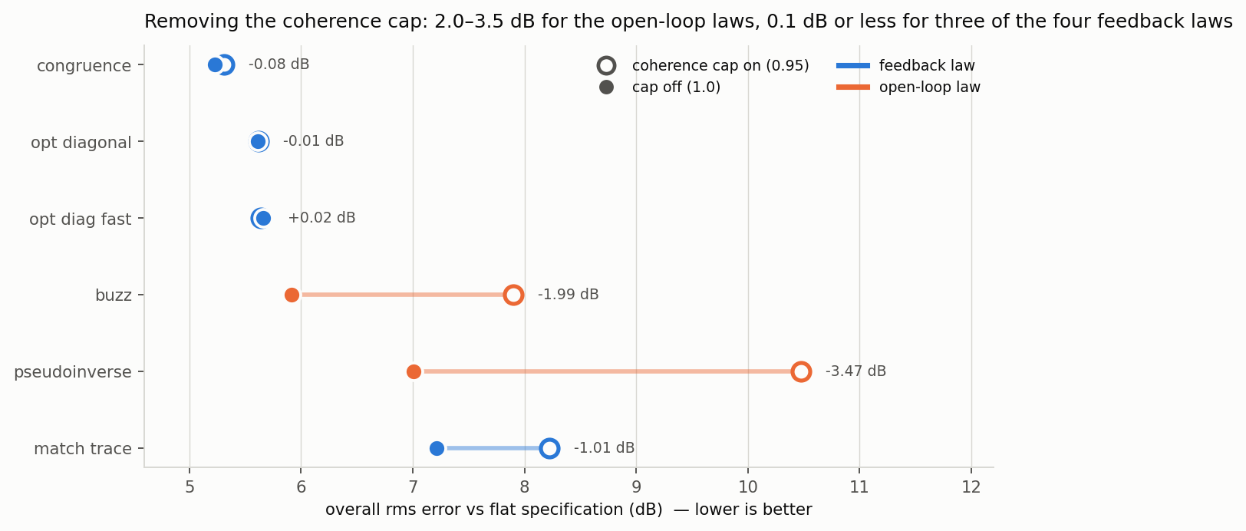
The coherence cap inverts by family
6
Same parameter, opposite meaning for feedback and open-loop laws
−3.47 dB
−1.99 dB
≤ 0.08 dB
pseudoinverse_control
gains from cap off
buzz_control
gains from cap off
three of four feedback
laws move by this
Notes:
The operational consequence: for pseudoinverse_control and buzz_control, cap off (1.0) is the CORRECT setting, not the reckless one. This is the reverse of the feedback-law intuition and nothing in the parameter name or the docstring warns of it.
The level offsets tell the same story more starkly than rms: run 09 sat +13.55 dB above spec with the cap on and −1.28 with it off; run 11 went +9.38 to −0.30.
match_trace is the one feedback law that loses a full 1.01 dB to the cap — but removing it costs 50x the drive power (0.12 to 6.02 V^2), so cap on is still the right call there.

Slide 7
Why the cap breaks the open-loop laws
7
The drive correlation is not incidental — it is the solution
1
The open-loop solve is nearly rank one
Eigenvalue participation ratio 1.0–1.1 out of 6. The six shakers act as essentially one source.
2
The responses cancel by precise inter-drive phasing
That phasing is carried entirely in the off-diagonal terms of the drive CPSD.
3
The cap shrinks off-diagonals, preserves the diagonal
Drive power barely changes — but the cancellation is destroyed and responses add incoherently.
4
A feedback loop re-converges around it. An open-loop law cannot.
Hence +13.55 dB on run 09. The residual is shape error, not level: the best single rescale recovers only 0.30 dB.
Confirmed in reverse: the best achievable drive sits above 0.95 coherence on 49 % of its pairs. The cap constrains the solution away from the optimum by construction.
Notes:
_cap_drive_coherence shrinks each off-diagonal term whose coherence exceeds the cap, preserving every diagonal value, then re-projects onto the PSD cone by clipping negative eigenvalues. Because the diagonal is preserved the drive trace is nearly unchanged — 14.54 V^2 either way in the offline reconstruction — yet the predicted response level jumps 21 dB.
The "shape not level" point is worth making: the optimal single rescale of run 09's entire drive improves it only from 10.47 to 10.17 dB. No gain correction rescues it.

Slide 8
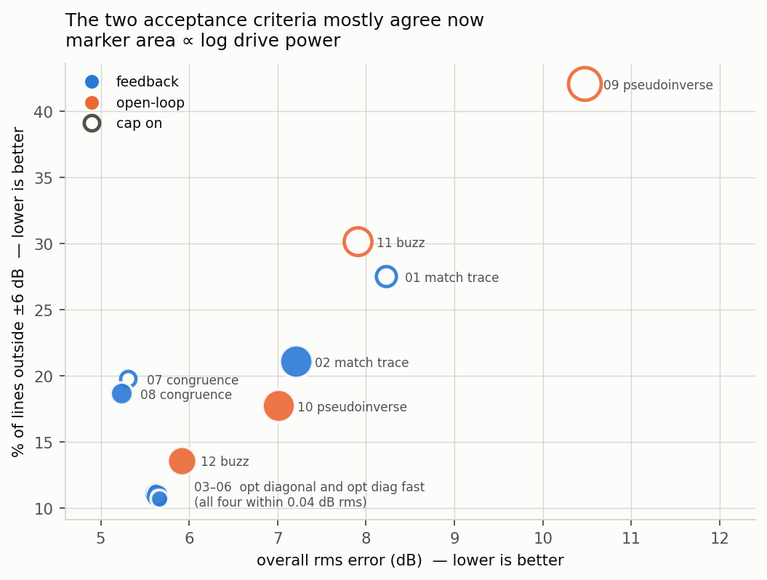
Feedback buys less than expected
8
A law with no error feedback finishes inside the feedback cluster
buzz_control has no feedback at all
last_response_cpsd appears in its signature and docstring and never in the body. last_output_cpsd is read only as a first-call sentinel. It recomputes the same open-loop solve every cycle.
Its one adaptive channel is the plant model
The FRF is re-identified during control, but sysid_response_cpsd — the source of the coherence and phase it matches — is frozen at system ID. It adapts to a changing plant, not to its own error.
So what separates the laws?
Not loop design. How sensibly each one picks a target inside the reachable set. buzz substitutes measured coherence and phase for the spec’s unreachable diagonal — worth 1.1 dB and a third of the drive against pseudoinverse.
Notes:
buzz_control at 5.91 dB / 13.6 % finishes 0.68 dB behind the best run in the matrix and ahead of both match_trace runs — with no error feedback whatsoever.
The reading this supports: on this plant the 5.2-5.9 dB cluster is set by reachability and identification quality, not by loop design.
Cheap experiment worth running: buzz_control with update_tf_during_control = N. That makes the law fully static after cycle one, so the difference against run 12 measures exactly what plant-model adaptation is worth with nothing else varying.

Slide 9
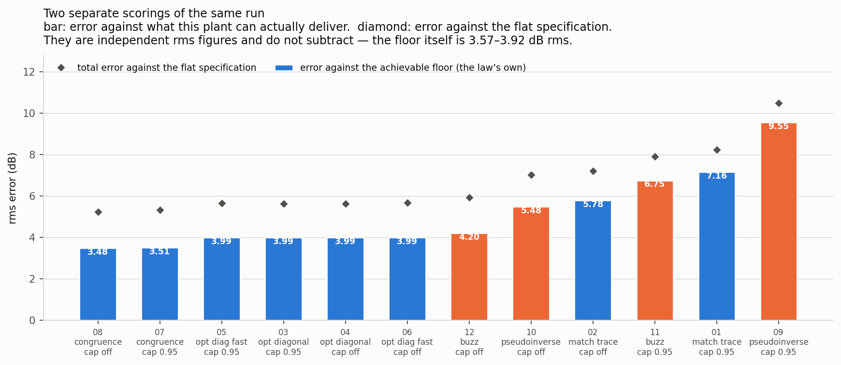
Separating the law’s error from the plant’s limit
9
Two independent scorings of the same run — they do not subtract
3.48 dB
3.99 dB
3.57–3.92
congruence — lowest
error against the floor
the whole optimal-
diagonal family
the floor itself
(dB rms, per run)
Notes:
The bar is error against what this plant can actually deliver — the law's own contribution. The diamond is total error against the flat specification. These are separate rms figures and do NOT subtract; an earlier analysis in this campaign treated their difference as the reachability limit and was wrong.
Ranked against the floor the ordering changes from the flat-spec ordering: congruence 3.48-3.51, optimal-diagonal family a flat 3.99, buzz 4.20, pseudoinverse 5.48, match_trace 5.78. congruence sits +2.8 dB high in level, which costs it against the specification but not against what was reachable.
The floor itself: for each line, solve over every X >= 0 for the drive whose predicted response diagonal comes closest to the spec, then take the rms of the per-line per-channel dB error over 901 lines x 8 channels.

Slide 10
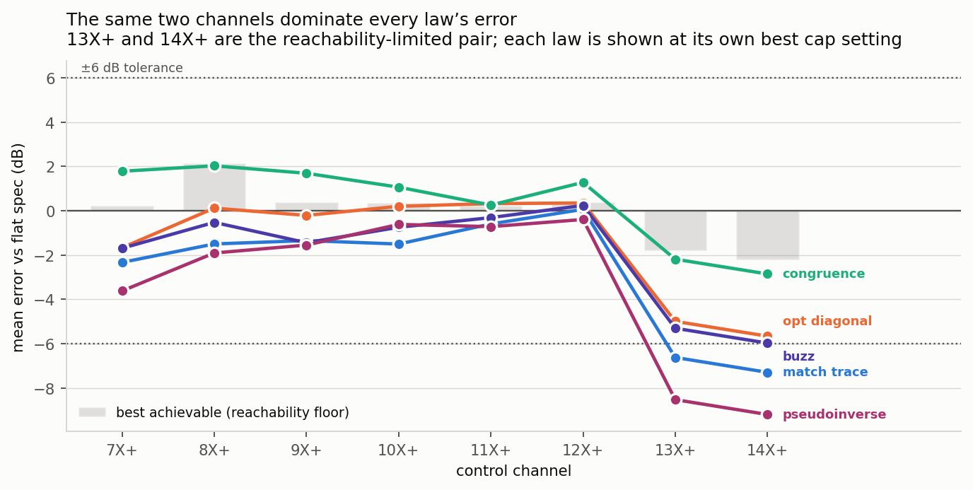
The same two channels dominate every law
10
13X+ and 14X+ are the reachability-limited pair
Five channels hold
8X+ through 12X+ stay within 2.1 dB under every law. 7X+ is marginal — inside 2 dB for four of five laws, −3.6 dB under pseudoinverse.
Every law undershoots the pair
congruence −2.2 / −2.8
buzz −5.3 / −6.0
match_trace −6.6 / −7.3
pseudoinverse −8.5 / −9.2
Notes:
These are the two directions six shakers cannot independently command. The laws differ mainly in how much drive they are willing to waste trying — congruence gives up soonest and scores best; pseudoinverse spends the most and does worst.
The floor itself has the same shape: its per-channel means are +0.22, +2.14, +0.39, +0.37, +0.24 and +0.39 dB on 7X+ through 12X+, and -1.79 / -2.20 on 13X+ / 14X+. So three channels carry the floor — 8X+ overshooting and this pair undershooting.

Slide 11
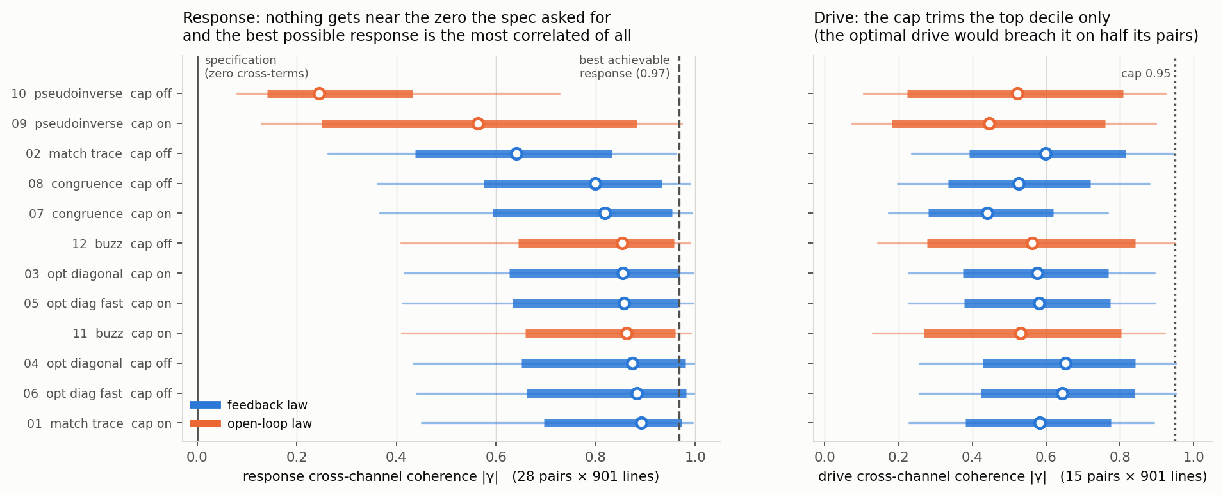
Cross-terms: the specification asked for zero
11
Nothing in any of these laws controls the off-diagonals
0.25 – 0.89
1.15 – 1.5
0.967
median response
coherence |γ|
effective response
directions, out of 8
coherence of the BEST
achievable response
Rank 5 < 8 control channels, so a diagonal response CPSD is unreachable — and the optimum is more correlated than almost every law delivered.
Notes:
The flat spec is diagonal — every off-diagonal term zero. Every one of these laws matches the DIAGONAL and lets the cross-structure fall out. It does not fall out small: off-diagonal magnitudes sit within a few dB of the 1e-3 diagonal.
Zero cross-terms is unreachable, not merely hard: H X H^H has rank at most 5 in an 8-dimensional space, while a genuinely diagonal 8x8 CPSD has rank 8. This is a second, independent way the spec sits outside the achievable set.
Run 10 is the control experiment: the only run with substantially independent responses (median 0.245, participation 4.46), bought with 5.38 V^2 — seventy times the optimal-diagonal family — to finish 1.4 dB worse. Decorrelating costs a lot and buys nothing, because nothing in the acceptance criterion looks at it.
If cross-terms matter for a real article, none of these laws gives control over them and no parameter setting changes that.

Slide 12
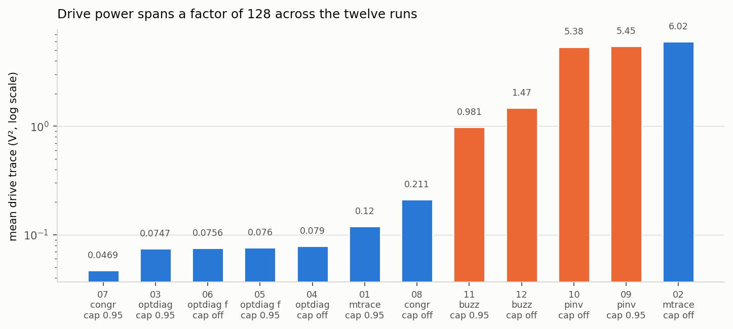
Drive power spans a factor of 128
12
If drive headroom binds rather than control accuracy, the ordering changes completely
0.047 V²
1.47 V²
6.02 V²
congruence, cap on —
the cheapest run
buzz, cap off — 20×
for 0.3 dB worse
match_trace, cap off —
50× its own capped run
Notes:
The open-loop laws are expensive. buzz uncapped uses 1.47 V^2, about twenty times the optimal-diagonal family, for a 0.3 dB worse score.
If drive headroom is the binding constraint rather than control accuracy, match_diagonal_congruence with the cap on wins outright at 0.047 V^2 — and that is the one case where keeping the cap on is clearly right, since it costs congruence only 0.08 dB.

Slide 13
Caveats and open defects
13
What these numbers do not support
Runs 05 / 06 did not test what they were meant to
optimal_diagonal_control_fast disables its Burer-Monteiro path whenever the FRF changes between calls. With update on, every solve fell back to the base SDP — they are repeats of 03 / 04.
The cap barely applied in the optimal-diagonal laws
It reaches only SDP-refined bins, capped at max_bins_per_update = 20 across 901 lines. Their null result may mean “barely applied”, not “does not matter”.
pseudoinverse_control has no startup guard
The only law in the set without the first-cycle clamp. On frame one the FRF is a single unaveraged estimate and the command can be decades high.
Identification scatter is large
Median cond(H) 2,447–25,928 across twelve identifications of one deterministic plant. Differences below a few tenths of a dB are not real.
One level, one averaging setting, one plant, no repeats
No per-law variance estimate exists. The plant is lightly damped, which is the harder case.
Notes:
Two more worth mentioning if asked. Run 01 may have been saved short of convergence — its optimal rescale is +3.37 dB, the only large one-sided offset under an integrating law. And an offline predictor used during the campaign called every ordering correctly and no magnitude within 2 dB, because it freezes the FRF the live laws keep updating.
Also: the profiles carry no warning or abort levels, so the +/-6 dB bands are synthesized from the specification. Putting real tolerances in the profile would make these numbers contractual rather than nominal.

Slide 14
Next
1
Find out why the plant is rank 5
If the sixth shaker is redundant by construction it matters for the rig, not just the model.
2
Higher damping, same geometry
higherz has identical mass and stiffness, ζ 0.83 → 3.34 %. Floor unchanged (4.05 vs 4.09) — it isolates identification quality.
3
buzz_control with the FRF update off
Makes the law fully static after cycle one. One run measures what plant-model adaptation is worth.
4
Raise max_bins_per_update, repeat 03 / 04
Settles whether the optimal-diagonal cap null result is real.
5
Decide whether cross-terms are in scope
Currently a diagonal-only comparison by default rather than by decision.
6
Add a startup level cap to the remaining laws
Open defect on both optimal-diagonal laws and pseudoinverse_control.
Report: Claude outputs/law_comparison_report_2026-09-15 · data: report_data.json, crossterm_data.json, singular_value_data.json
Notes:
Items 1 and 2 are the ones to argue about. The rank question is not a modelling curiosity: if the sixth shaker is redundant by construction then the rig has a drive channel doing nothing and the problem has always been 8x5.
Set expectations correctly on the higher-damping campaign: it will NOT move the floor. It tests only whether the law spread narrows because identification improves — conditioning over the live directions halves, 68 to 33.

